Slide 1

Introduction to threat modelling and the Rapid threat model prototyping methodology (rtmp)
Geoffrey Hill

Slide 2
Can you explain clearly Why we have a secure SDLC process?

Slide 3
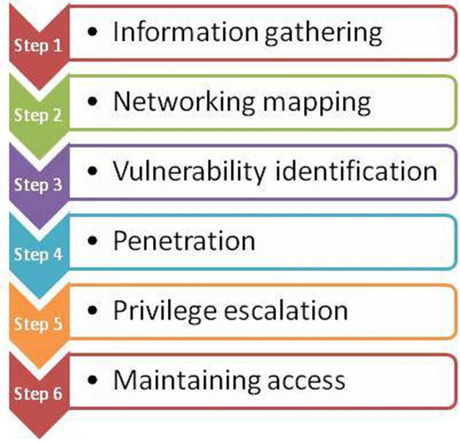
How can we leverage a cyber kill-chain better?
Notes:
I would put PRIVILEGE ESCALATION, but an argument can be made for each step.

Slide 4
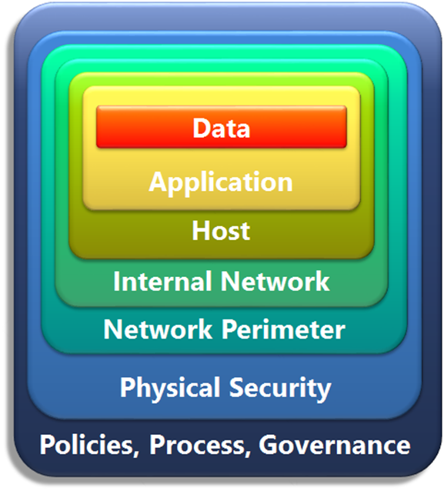
How can we leverage Defense-in-depth more accurately in a system?
Similar to OSI layers
Each layer has independent security
Data is crown jewels

Slide 5
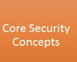
SSDLC principles
secure by design
Defense in depth
Secure by default
Identity
Least privilege
Secure in deployment
Ports
protocols

Slide 6
STRIDE
What relationships exist between stride and the ot10?
OWASP Top 10
(2017)
Injection
Broken Authentication
Sensitive Data Exposure
XML External Entities (XXE)
Broken Access Control
Security Misconfiguration
Cross-Site Scripting (XSS)
Insecure Deserialization
Using Components with Known Vulnerabilities
Insufficient Logging & Monitoring
Spoofing is the inverse of Authentication
Tampering is the inverse of Integrity
Repudiation is the inverse of Authentication and/or integrity
Information Disclosure is the inverse of Confidentiality
Denial of Service is the inverse of Availability
Elevation of Privilege is the inverse of Authorization
Notes:
A4 is a form of Injection attack. One of the mitigation layers is to add XSD template processing, or use JSON.

Slide 7
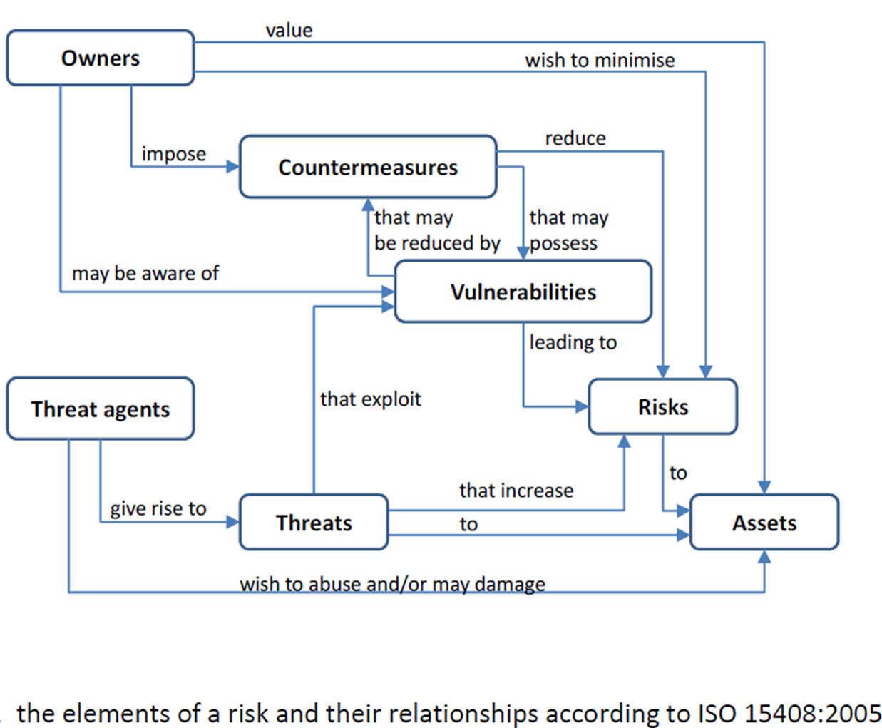
How issues link together

Slide 8
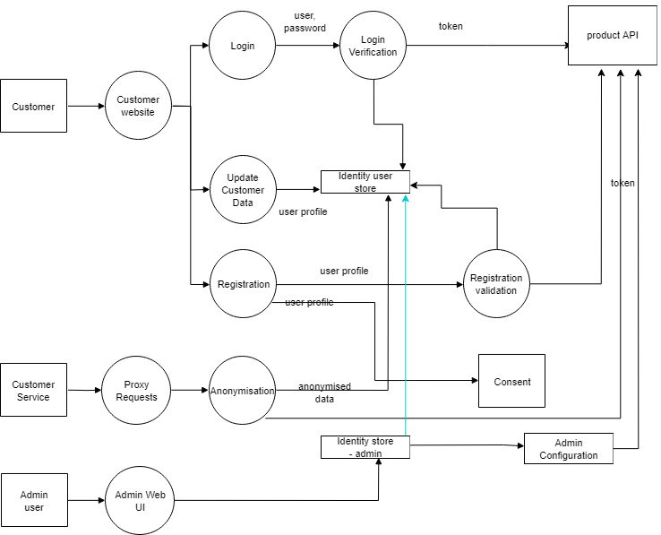
the representative diagram
We will use this as the sample diagram in the slide deck

Slide 9
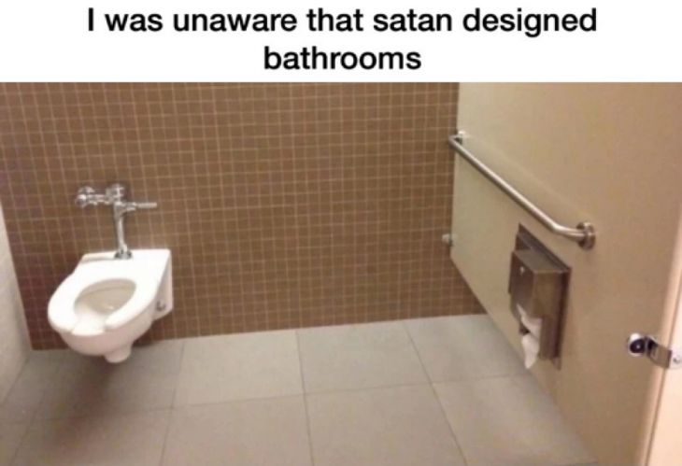
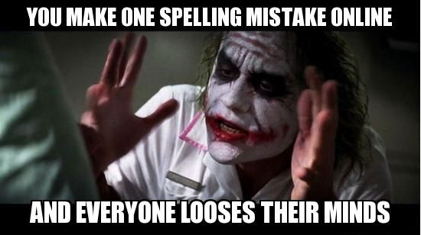
Flaws versus bugs
Notes:
Flaws are design-time mistakes that generally lead to a number of security issues and are difficult to fix because of dependencies, eg. Not planning access control on certain objects in the design, planning a poor security authentication pattern.
Bugs happen during implementation… developers introduce bugs when their code doesn’t take into account all the potential actions that can exist. Example would be to concatenate user input into html, causing a Cross-site scripting (XSS) issue.

Slide 10
threat modelling 101

Slide 11
Threat Model type Asset Based – What are you protecting? Attacker Based – What would an attacker do? Defensive Based – What should I protect against?
Model the system
Representation & type
Understand Zones of trust
dependencies
Analyse the threats
Use taxonomies to find threats
Look for authorisation mismatches
Do Mitigation analysis
Accept
Reduce
transfer
Validate the threats and mitigations
Static code review
testing
Model
Analyse Threats
Analyse Mitigations
Validate
Threat Model type

Slide 12
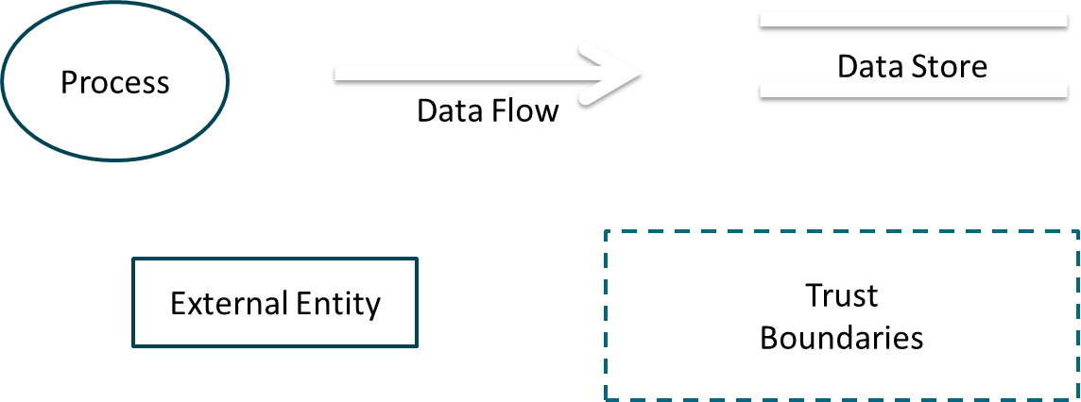
Basic Threat Model Elements
DataStore
DataFlow
Process
+ THREATS
External Entity
Trust Boundaries
+ MITIGATIONS

Slide 13
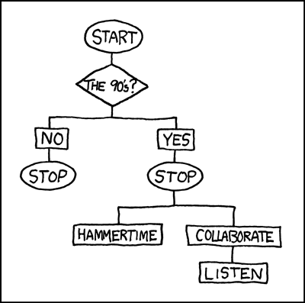
Model the system
Review
Documentation
Requirements
models
Interview
Business owners
architects
Discuss how best to do this in an Agile environment
How involved do we want the interviewees?

Slide 14

Our focus will be a Defender-based model
Teams understand when they need to defend
Use STRIDE to model the attackers
Approach doesn’t need a security expert
Describe possible attacking types/vectors
Create security controls to limit access to those types

Slide 15
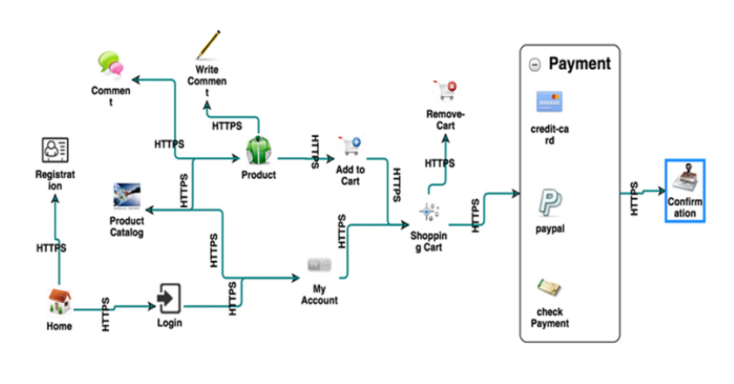
use a context or process diagram
Try to use existing software diagrams
Try not to create other diagrams (such as DFDs)
Start the conversation
80/20 rule
Process flow diagram (PFD) example

Slide 16

Know your dependencies
Which elements are connected to external systems
What do these elements require from those systems?

Slide 17
Now… Deduce some potential dependencies

Slide 18
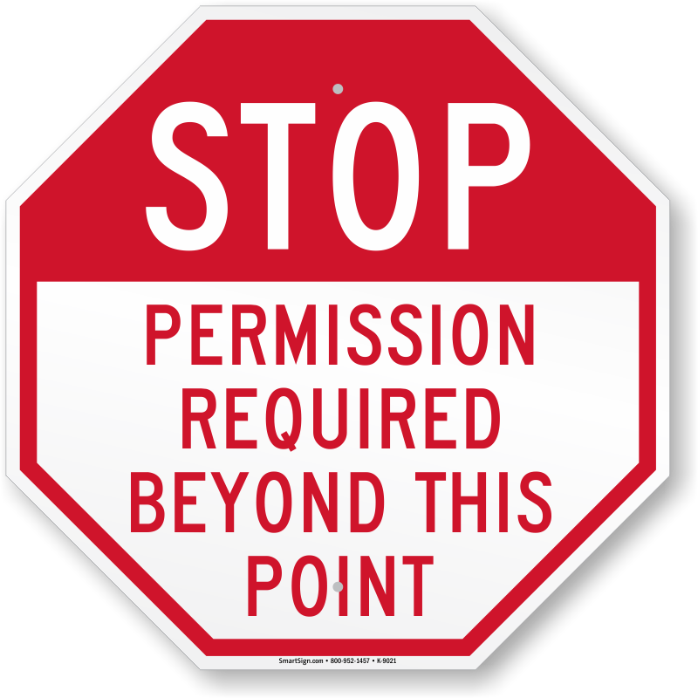
Understand Zones of trust
We need to know Trust Zones in order to understand the Attacker’s Advantage and Defender’s Dilemma.
Segregate model elements into Access levels
Elements in same level don’t need more permissions to connect
Elements in higher levels require more permissions to connect
Notes:
Attacker’s advantage… the attacker has all the time to find a weakness in the system.
Defender’s dilemma… defend everywhere or focus on one area to defend?

Slide 19
add trust boundaries to this diagram

Slide 20

Analyse the threats
Iterate through all elements
Discuss weaknesses of each element or dataflow
List potential attack vectors (stride?)
Exploit weak access permissions
Read data in the clear
Spoof client identity

Slide 21


Accept
Managers
Get signoff from stakeholder(s)
Stakeholder accepts the risk of attack
Does NOT fix the weaknesses!!!
Sometimes necessary for business reasons
Example
Delay implementation to fix issues
Executives
Discuss examples from work

Slide 22
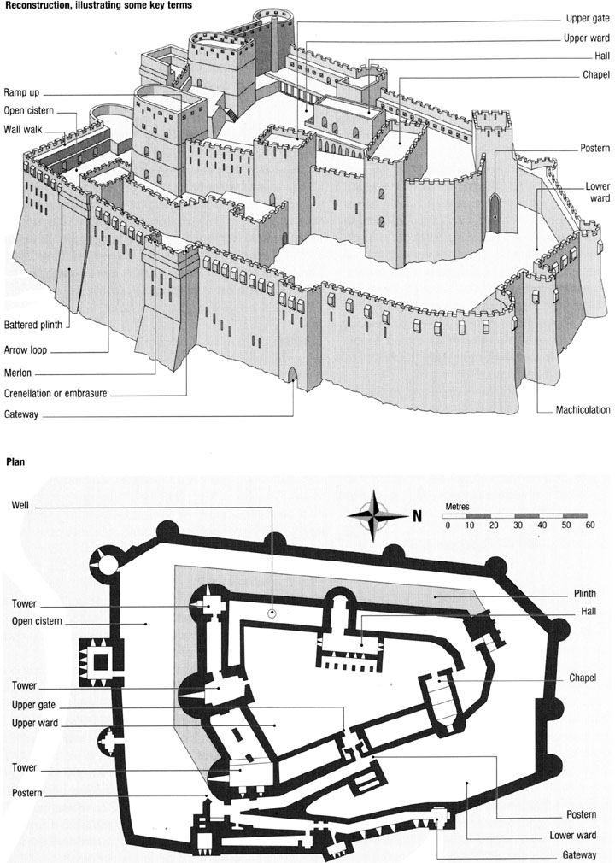
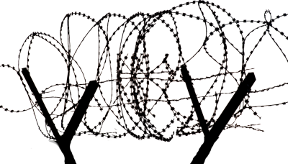
Reduce
Add technical mitigations to reduce the chance of exploitation
Mitigations patterns should be created
Mitigations should be re-used in project or other systems

Slide 23

Analyse the threats
Iterate through all elements
Discuss mitigations for each threat
List potential attack vector controls (using OT10?)
Restrict by roles (access)
Implement TLS (clear)
Force ID check
(spoof)

Slide 24
Validate the threats and mitigations
Overall Risk Severity
Impact | High | Medium | High | Critical
 | Medium | Low | Medium | High
 | Low | Informational | Low | Medium
 |  | Low | Medium | High
 | Probability
Triage the threats to prioritise
Verify the mitigations are implemented through Static code review
Verify the threats don’t exist through Testing
Create test cases for each

Slide 25
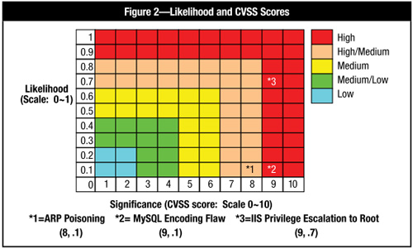
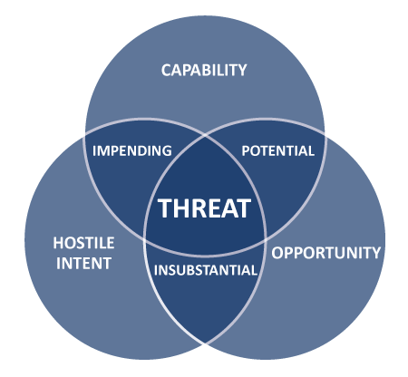
Prioritisation methods for triaging
Probability/Impact Assessments
Avoid exact numbers!
RAG status is simple and it works
Measuring Impact
Measured against business objectives
Use a RAG status again
Notes:
The final methodology is a Probably/Impact assessment
RAG = Red/Amber/Green
DREAD = Damage, Reproducibility, Exploitability, Affected Users, Discoverability (0..10)
CVSS
Access Vector (Local, Adjancent Network, Network)
Access Complexity (H, M, l)
Authentication (M, S, N)
Confidentiality (N, P, C)
Integrity
Availability
Probability
Probability is very difficult to accurately measure
Fixed probabilities are difficult, subject matter expertise is often needed
Avoid absolute probability measurements (such as 30%)
High/Medium/Low is generally more practical for security guys
Threat Actor Factors
Skill Level
Motive
Opportunity
Vulnerability Factors
Ease of discovery
Ease of exploit
Awareness
Impact
Impact is measured against the business objectives for the system
In some cases, specific money values can be assigned to the potential impact, but this is difficult
High/Medium/Low is generally more practical for security guys
Technical Impact Factors
- Loss of confidentiality
- Loss of Integrity
- Loss of Availability
- Loss of Accountability
Business Impact Factors
Financial damage
Reputation damage
Non-compliance
Privacy violation

Slide 26
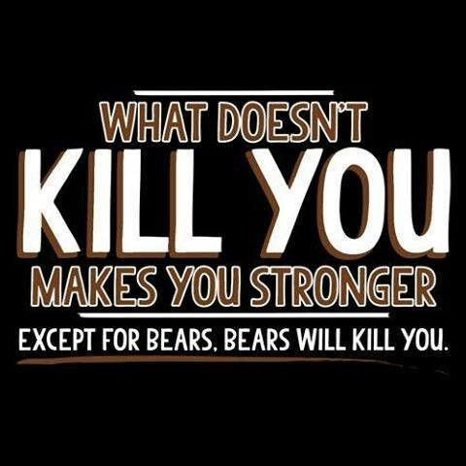
Lab
Each group annotates diagram with threats and mitigations
Identify 1 threat for each element or flow
Identify 1 mitigation for each found threat
Assess risk

Slide 27
rapid Threat Model prototyping methodology –Threat ModelLing 201… evolved
Identify business requirements by
using agile Architecture – Intentional Architecture
Conceptual Design
using Agile Architecture – Emergent Design
test the prototype
with zones of trust
Revise and enhance
Just enough information… 80/20 rule

Slide 28
Rapid Threat model prototyping - goal
CONSISTENT data
REPEATABLE data
MEASURABLE data
For CI/CD & DevOps
Notes:
Make inputs and outputs consistent to enable inclusion in an automated CI/CD & DevOps environment

Slide 29
Overview of Agile Architecture
First part
Intentional architecture
Consistency for changing environments
Enabling cross-team design
reduces redundancies
Notes:
Intentional architecture
needed where many changes happen in many environments
provides a framework for cross-team design and implementation synchronization
reduces the production of redundant and/or conflicting code and designs

Slide 30
Overview of Agile Architecture
Second part
Emergent design
Organic grown by team
Continuous Integration and Testing steps
Changing requirements will change design
Notes:
Emergent design
Grown incrementally by those who are closest
Evolves by constant testing and Continuous Integration steps
Design grows in accordance with the currently known requirements

Slide 31
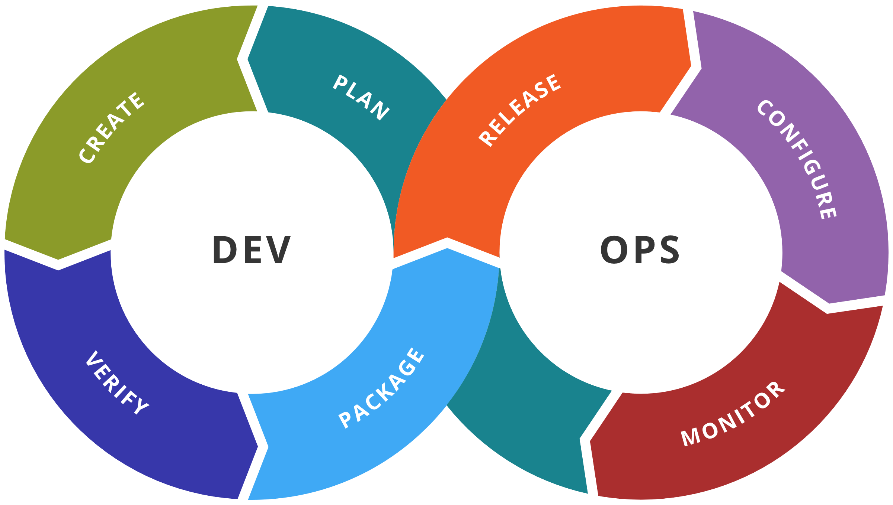
How to fit this into Devops
Risk tools
dashboards
Send output to risk register and sprint backlog (e.g. Jira)
Triage on calculated Risk
T-shirt-size on calculated Risk

Slide 32
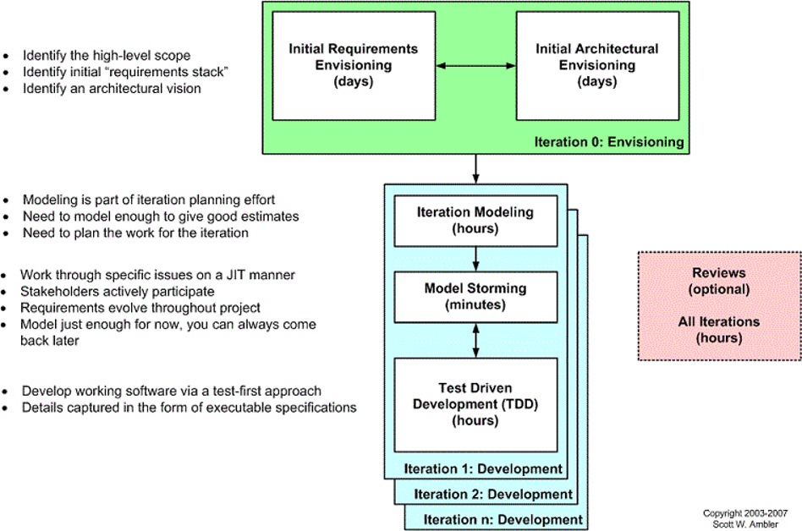
Agile architecture in-sprint
SCOPE
REQUIREMENTS
VISION
Model Storming to adapt new requirements
Do not create detailed up-front designs
Add data to diagram to keep in-sync

Slide 33
Why elevation of privilege is bad Attack Kill Chain again
We need to find Elevation of Privilege issues quickly
Notes:
Why you want to identify Elevation of Privilege threats first… the most dangerous attack step is the C&C step.

Slide 34
Key Concept Trust Zones become numbers (1)
0
Find Elevation of Privilege issues quickly by “Zone Math”
Look at the difference in values between zones
Greater difference means more dangerous flow
(can automate the process)
0
0

Slide 35
Key Rule Lowest Valued Zones (2)
0
Zone 0
(always non-trusted)
Designate any uncontrolled element as Zone 0
An uncontrolled element is any element that is outside the control of the system you are modelling
(it can be inside the company control though)
This enforces defense-in-depth
0
0

Slide 36
Key Concept highest valued trust zones (3)
?
?
In general, Data-at-rest (or when data hits the disk) should be highest zone in diagram
Represents highly trusted elements
?

Slide 37
Key Concept Boundary Trust Zones (4)
1
Zone 1
(always boundary or DMZ)
Known boundary elements are Zone 1
public API endpoints
websites
1
1

Slide 38
?
?
?
?
?
Lab – add the zones
?
?
?
?
?
?
?
?
?
?
?
?

Slide 39
Zone Rules start with access control
E
E?
Easily apply STRIDE to diagram using numbered Zones of Trust
ELEVATION OF PRIVILEGE threats exist on TARGET elements connected from lower to higher zones
E
E
Lab – do the rest

Slide 40
Zone Rules Identity
S
(S)
Spoofing threats exist on TARGET elements connected from UNCONTROLLED to inside
S
S
Lab – do the rest

Slide 41
Zone Rules Validation integrity
T
Tampering threats exist on dataflows connected from lower to higher zones
Elevation of Privilege provides tampering weaknesses
T
T
Lab – do the rest

Slide 42
Zone Rules Session
R
Repudiation threats potentially exist on TARGET elements that have spoofing with tampering on the inbound dataflows
Repudiation requires
Anonymity
Removal of proof of ID
R
Lab – do the rest

Slide 43
Zone Rules Confidentiality
I
Information Disclosure threats exist on dataflows from higher to lower zones
More sensitive data gets leaked in a less sensitive zone
I
Lab – do the rest

Slide 44
Zone Rules Availability
D
Denial Of Service threats exist on elements or dataflows connected to the UNCONTROLLED
The highest probability of Denial of Service happens where control of the data is weakest
D
D
Lab – do the rest

Slide 45
Map mitigations based on anti-STRIDE properties (here are some examples)
Spoofing is the inverse of Authentication
Tampering is the inverse of Integrity
Repudiation is the inverse of Authentication and/or integrity
Information Disclosure is the inverse of Confidentiality
Denial of Service is the inverse of Availability
Elevation of Privilege is the inverse of Authorization
OIDC
AC, sign
OIDC, OAUTH2
TLS, encrypt
Data constrain
OAUTH2

Slide 46
Pick a software design you have done and iterate through each of the RTMP rules to get the default STRIDE threats
Lab
Do your own threat model
?

Slide 47
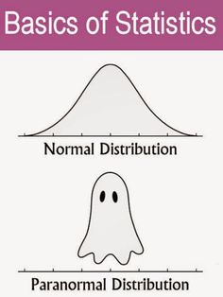
rapid Threat Model prototyping methodology – measuring risk… threat modelling 301

Slide 48
Key Concept Kill chain provides rough impact
Figure where attack needs to be in kill-chain
impact value becomes the value of kill-chain level
Notes:
A quick way to estimate probability and impact is to figure out where the attack needs to be in the kill-chain. This level will provide guidance on where to put the probability and impact elements.
For example, if an attack needs to be at Step 3 (Vulnerability Identification) to be really successful, it could be estimated at Medium probability and Medium-High impact, depending on other factors that come out in discussion.

Slide 49
Key Concept Zone math shows probability
SE
2/6
Add number of STRIDE found
Divide by total STRIDE
Ratio of 6, higher number has higher probability
SE
2/6
SE
2/6

Slide 50
Key Concept Zone math shows dangerous flows
5
6
Find jumps in Zone values of greater than 1
greater jumps in a dataflow are more dangerous
0
2
3

Slide 51


